Slide 1
Tell a Story
Spend 2-3 minutes telling the person next to you a small personal story about some environmental action you have taken

Slide 2
How Do We Talk About Climate Change?
The Psychology of Environmental Messaging

Slide 3
What I hope you will take away
A practical understanding of some of the psychological aspects unique to climate change and how it influences messaging
A knowledge of the key aspects of stories / narratives and their value to climate change communication
The ability to evaluate messaging using audience segmentation

Slide 4
WHAT SCIENCE HAS DONE

Slide 5
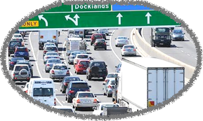
Psychological Distance
the self
NOW
PERCIEVED
IMPORTANCE
CONCRETE

Slide 6
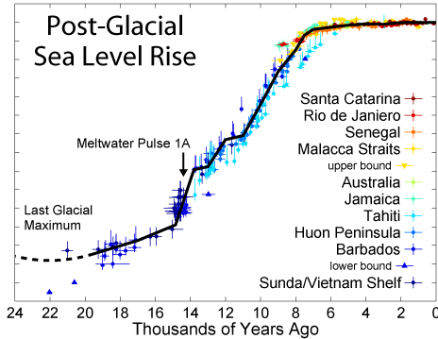
Psychological Distance
the self
FUTURE
PERCIEVED
IMPORTANCE
ABSTRACT

Slide 7
Psychological Distance
One of the reasons for psychological distancing is to manage or mitigate a sense of risk or threat to our self.
Its a very useful defence mechanism to reduce overwhelming ourselves and therefore reduce anxiety

Slide 8
Characteristics of climate change that can lead to psychological distancing
Invisible Causes
Distant Impacts
Delayed or absent gratification for taking action
Complexity and Uncertainty

Slide 9
Psychological Distance
“Psychological research shows that direct experience and immediate demands trump vicarious experiences or abstract data almost every time.”

Slide 10
Communicating to reduce the possibility
of psychological distancing
People are more likely to be willing to act on climate change if they think that it will impact them, or people they care about and who are similar to them, in the immediate future
So information needs to be not merely local in a geographical sense, but local in terms of psychological distance

Slide 11
Communicating to reduce the possibility
of psychological distancing
Communicate Solutions
Don’t over simplify or trivialise people’s position
Use the right images
Tell human stories

Slide 12
The Power of Stories
“Stories are both ways for us to transmit our goals and actions and to be inspired by the goals and actions of others”

Slide 13
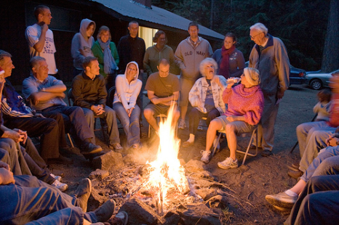
The Power of Stories
Stories are easily passed on;
people naturally tell them and listen to them.
The relate to day-to-day lives, that is, they aren't an abstraction

Slide 14
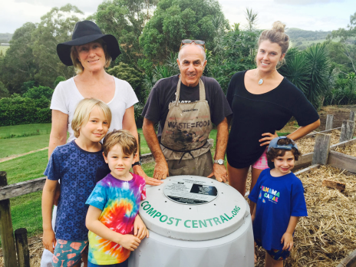
The Power of Stories
The often have an emotive element which hooks us in and increases the likelihood of it being remembered
Stories around climate action are mostly pro-environmental

Slide 15
Fearful Communications
Often fear is employed as a communications device to grab people’s attention, and this is one of the reasons it widely used in mass media, but one of the issues it that fear based campaigns don’t seem to have long-lasting impacts.

Slide 16
Fearful Communications
This is not to suggest that communicators should never deliver information which outlines risk, but rather, not relying solely on fearful communications.
While fear of a negative outcome can be an effective way of promoting behavioural changes, the link between the threat and the behaviour must be personal and direct.

Slide 17
Groups & Social Norms
Humans are essentially social beings, and their identities in social groups play a seminal role in the development of their attitudes and behaviours.
People process information differently in groups and communicators can harness groups to get people engaged on climate change.

Slide 18
Groups & Social Norms
One of the benefits of communicating with people in groups is that people will often consider a wider range of possible options and show deeper engagement with arguments and courses of actions being proposed.

Slide 19
Social Norms
Social norms are the ways in which people take inferred information about a setting or situation, which in turn influences how they adjust their behaviour.
Rather than looking to try and change individual behaviours, there may be more value in approaching communication which seeks to promote social norms.

Slide 20
Hotel Towel Research
Looked at the difference in compliance rates of hotel guests for requests to reuse their towels
Two messages were used…

Slide 21
Hotel Towel Research
HELP SAVE THE ENVIRONMENT. You can show your respect for nature and help save the environment by reusing your towels during your stay.

Slide 22
Hotel Towel Research
JOIN YOUR FELLOW GUESTS IN HELPING TO SAVE THE ENVIRONMENT. Almost 75% of guests who are asked to participate in our new resource savings program do help by using their towels more than once. You can join your fellow guests in this program to help save the environment by reusing your towels during your stay.

Slide 23
Identifying Audience Segments
Australian research has identified three main segments and evaluated how each of these responded to climate change messaging
Segment | Characteristics
Dismissive (20%) | • Very little belief in climate change • Effects perceived as remote in space and time • Very low levels of distress, concern, perceived risk, environmental values, trust in authorities, and self-efficacy • Low levels of outrage and knowledge • Negative attitudes toward clean energy
Uncommitted (45%) | • Moderate belief in climate change • Effect perceived as moderately close in space and time • Moderate distress, concern, perceived risk, attitudes toward clean energy, trust in authorities, and self-efficacy • Moderately low levels of outrage, environmental value, and knowledge
Alarmed (34%) | • Strong belief in climate change • Perceived effects to be very close in space and time • High levels of distress, outrage, concern, perceived risk, knowledge and self-efficacy • Strong environmental values, trust in climate change authorities, and attitudes toward clean energy

Slide 24
Identifying Audience Segments
Segment | Messaging options and Policy Strategies | Effective Messages
Dismissive | • Avoid direct references to climate change and sustainability • Develop strategies that emphasise other valued outcomes (e.g. economic development or a caring society) | • Use simple language • Do not emphasise messages which describe how people SHOULD think or behave • Provide specific advice about what actions to take
Uncommitted | • Provide motivational messages to increase self-efficacy and concern | • Have a strong emotional component • Are framed in terms of preventing losses • Provide specific advice about what actions to take
Alarmed | • Provide information about: o effective ways to minimise personal carbon footprint o how to lobby industry and government o where to access relevant means and resources • Remove structural barriers preventing translation from intention to action • Provide feedback that climate change views are shared by others (as ‘social proof’) | • Emphasise local impacts • Emphasise collective responsibility • Provide specific adaptation advice about what actions to take

Slide 25
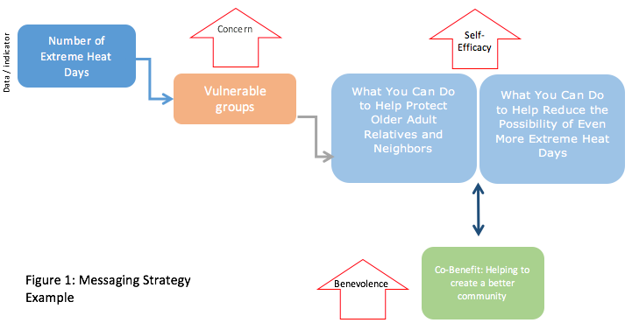
Example Messaging Strategy
for ‘Uncommitted’ Segment

Slide 26
What else is in the report
Communicating with Specific Audiences:
Politically Conservative,
Young People,
Uncommitted or Unconcerned Groups: The case for co-benefits
Examples of campaigns targeting uncommitted groups, and targeting multiple groups
WAGA councils messaging case studies
Blank evaluation sheet

