Slide 1
EUA Finance for the Regions: The economic benefits of retrofitting Victoria’s building stock through Environmental Upgrade Agreements January 2014
An joint initiative of the Victorian Greenhouse Alliances

Slide 2
Contents
Summary
Objectives and scope
Methodology
An overview of EUA finance
The size of the retrofitting opportunity in Victoria
The opportunity for the Eastern Alliance for Greenhouse Action (EAGA)
The opportunity for the Northern Alliance for Greenhouse Action (NAGA)
The opportunity for the South Eastern Councils Climate Change Alliance (SECCCA)
The opportunity for the Western Alliance for Greenhouse Action (WAGA)
Case study: Baptcare
Recommendations for Local Government
Assumptions, Limitations and References
Further Information

Slide 3
Summary
This report quantifies the economic benefits that may flow from facilitating access to EUAs: +$4.5B of investment and +18,000 jobs across Victoria.
Retrofitting buildings for energy efficiency is one of the lowest cost means of reducing greenhouse gas emissions.
Environmental Upgrade Agreements (EUAs) are a mechanism for building owners to access attractive finance for retrofitting.
EUAs are available in the City of Melbourne as the key financing tool for the 1200 Buildings program (and are also available in some New South Wales municipalities).
A change in the Local Government Act would enable other Victorian councils to implement EUAs.
EUA finance can overcome structural and market barriers to retrofits, resulting in greater financial investment and increased employment in Victoria’s regions.

Slide 4
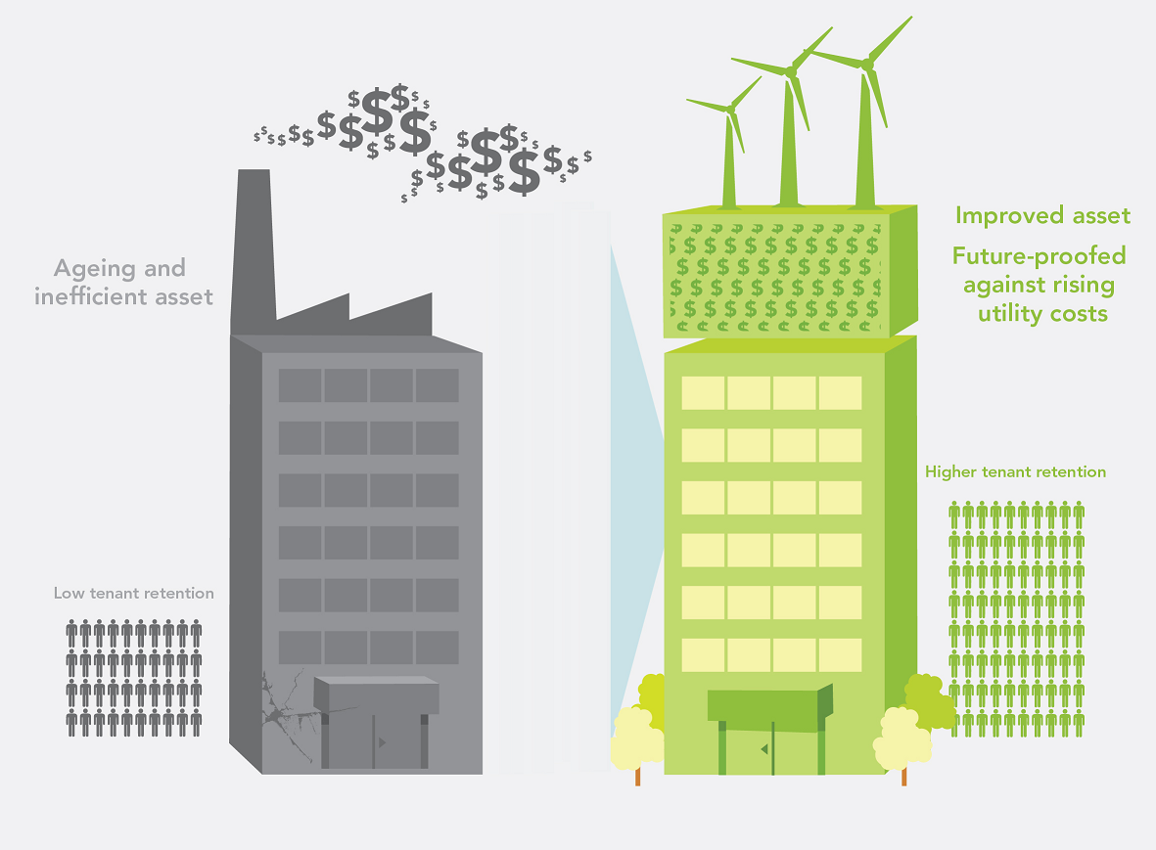
Objectives and Scope
This study quantifies the potential direct economic benefits that may be unlocked though allowing access to EUAs for each region in Victoria.
The report makes recommendations to local government about how to support the necessary changes to the Local Government Act.
The study does not include an assessment of indirect economic benefits (energy savings, product demand or indirect jobs) or a preferred administration model for the EUA mechanism.
Source: Sustainable Melbourne Fund

Slide 5
Methodology
The work presented is secondary research that draws on key reputable studies (see Assumptions, Limitations and References section).
The research included:
quantifying the floor space and number of properties within each municipality (<50m²) using data provided by the Valuer General Victoria
a segmentation model of all commercial building stock within each greenhouse alliance’s region
applying a plausible upgrade scenario (15% additional to business as usual)
making conservative estimates of the direct capital investment and employment opportunities resulting from a range of energy and resource efficiency opportunities relevant to EUAs.
The analysis and underlying assumptions have been peer-reviewed by the following technical experts: Sustainable Melbourne Fund, ARUP, AECOM.

Slide 6
An overview of EUA finance
An EUA is a three-party agreement between a building owner (borrower), a financial institution (lender) and a Local Government Authority (LGA).
A loan to the building owner for retrofitting is repaid to the lender via the LGA. The EUA links the loan to the building rather than the building owner, enabling loan repayments to be made through a property charge, just as Council rates are paid.
The property charge can be passed to tenants. This overcomes the ‘split incentive’ faced by landlords who usually have no incentive to invest in efficiency measures because tenants pay the utility bills.
Lenders benefit from greater loan security and therefore offer attractive terms.
Property owners benefit because the loan eliminates the need for upfront expenditure to undertake facility upgrades.
Tenants benefit from reduced operating costs, offsetting the property charge (see explanatory video)

Slide 7
EUA finance can unlock +$4.5B of investment and create +18,000 jobs across Victoria
City of Melbourne All other municipalities
Establishing EUA finance beyond the City of Melbourne provides an opportunity to reduce the risks for building owners and tenants from increasing energy costs, deliver low cost abatement within the buildings sector, stimulate investment and grow the local building retrofit industry.

Slide 8
Beyond the City, EUA finance can unlock +$800M of investment and +3,200 jobs across NAGA
Estimates for the City of Melbourne vary significantly. Deloitte’s report on the 1200 Buildings Program used a more ambitious upgrade scenario (70% of all commercial offices) and estimated the investment potential at ~$2B and 8,000 jobs. Under either scenario, municipalities beyond Melbourne’s CBD stand to benefit from EUA finance.

Slide 9
EUA finance can unlock over $700M of investment and create +2,800 jobs across the EAGA Region
EAGA’s region covers approximately 3,000km2, extending from densely populated urban areas in the west to less populated rural areas in the east. The industrial areas in Knox, Maroondah and Monash are a major contributor to Victoria’s manufacturing sector and could enjoy significant productivity outcomes through building upgrades.

Slide 10
In the SECCCA region, EUA finance can unlock over $880M of investment and create +3,500 jobs
SECCCA’s Councils cover a diverse and widespread region, with world-class tourist destinations, major retail and commerce centres, rich agricultural land and a burgeoning residential growth corridor. It is also home to one of Australia’s major and most dynamic manufacturing hubs.

Slide 11
EUA finance can unlock over $1.1B of investment and create +4,700 jobs across the WAGA Region
The identified potential in municipalities west of Melbourne is consistent with the findings of WAGA’s ‘Big Roofs’ project, a study which mapped the largest roofs across the region and identified some 14km2 of industrial roof space that could be used to harvest water and energy.

Slide 12
EUA finance could unlock over $200M of direct investment and create +800 jobs in Central Victoria
Central Victoria Greenhouse Alliance provides the largest environmental upgrade investment opportunity of all alliances within regional Victoria. The cities of Greater Bendigo and Ballarat support the majority of this opportunity, particularly in the sectors of manufacturing, warehouse, distribution and storage, and commercial office, retail, hospitality and tourism.

Slide 13
Within the GBGA region, EUA finance can unlock over $100M of investment and create +430 jobs
The GBGA region supports a large fruit and vegetable food processing industry centred around Shepparton and Cobram, the infrastructure of which provides substantial investment opportunity through EUA finance. Infrastructure associated with commercial activity and tourism also provides considerable opportunity for economic investment in the region.

Slide 14
Within the GCCN region, EUA finance could deliver $130M of investment and 530 jobs
Direct employment resulting from environmental upgrades would provide an injection of economic growth in the building retrofit/service industry to the Gippsland region.

Slide 15
Within the NEGHA region, EUA finance can unlock almost $84M of investment and create +330 jobs
Large roof space associated with manufacturing, warehouse and storage buildings provide the ideal opportunity to maximise energy and water resources with the installation of solar PV and water catchment measures under the EUA finance initiative.

Slide 16
Within the SWSP region EUA finance can unlock more than $77M of investment and create +310 jobs
Large roof space associated with manufacturing, warehouse and storage buildings provide the ideal opportunity to maximise energy and water resources with the installation of solar PV and water catchment measures under the EUA finance initiative.

Slide 17
Within the WMSA region EUA finance can unlock more than $30M of investment and create +120 jobs
Office, retail and hospitality/tourism businesses within large towns such as Horsham and Ararat hold economic opportunity for the Wimmera-Mallee region in environmental upgrade of existing building stock through EUA finance.

Slide 18
Case Study: Baptcare
The data presented in the table is based in recommendations from a detailed energy audit at an aged care facility.
Due to capital constraints, Baptcare would be unable to finance all of the initiatives recommended in the report.
The organisation has confirmed that it would proceed with the upgrade to this facility, as well as other sites, should EUAs become available (see letter of support).
 | Traditional Debt | EUA
Project size | $277,990 | $277,990
Loan amount | $305,789 | $305,789
Interest rate | 8.000% | 7.000%
Years of loan | 3 | 15
Payments per year | 12 | 4
Payment | ($9,582) | ($8,273)
Annual payment | ($114,988) | ($33,090)
Annual savings from efficiency measures | $26,779 | $26,779
Project simple payback | 11.4 | 11.4
Net annual cost | ($88,209) | ($6,311)

Slide 19
Progress to date and the outlook for the regions
The uptake of EUAs is just beginning – the mechanism has been available within the City of Melbourne since April 2011 with five deals so far.
The rate of uptake is consistent with a depressed market and a sluggish building sector over this period.
The building sector is largely unaware of EUA finance. Businesses may be sceptical of ‘win-win’ solutions or suffer the perception that EUA agreements are ‘complex’.
The requirement for ‘tenant consent’ in the City of Melbourne is an additional barrier to uptake in multi-tenanted buildings.
Beyond the City of Melbourne, the proportion of owner-occupied buildings and facilities is higher, so there are less communication and stakeholder engagement barriers.
Federally funded resources and tools are currently available to raise awareness and assist SMEs to capture EUA-related opportunities. These resources could be leveraged to address educational and skill barriers in the regions.

Slide 20
Recommendations for Local Government
Provide a letter of support to this study – Affirm your Council’s and Alliance’s support for the necessary legislative reform and demonstrate the demand for EUA finance to the Minister for Local Government.
Actively engage with the State Government to amend the Local Government Act and enable EUA finance – This study shows clear and significant economic benefits to Victoria from this minor, no-cost legislative change.
Advocate for the adoption of a nationally consistent administration model – South Australia’s Business Case Report evaluates the preferred approach for administering an EUA scheme and recommends adoption of an independent third-party administrator model. This replicable approach could create economies of scale for Councils wanting to voluntarily opt in over time (and consistency for businesses operating over multiple jurisdictions).

Slide 21
Assumptions, Limitations and References
Input | Assumption | Source | Consideration / Limitations
Upgrade scenario | 15% uptake or penetration rate | Arup (2012) Quantifying the environment and economic opportunities from retrofitting commercial buildings across SA: SA Segmentation study, p.21 | A conservative retrofit scenario of 15% above business as usual has been chosen – this is consistent with the low uptake scenario modelled by ARUP in the recent SA study More ambitious scenarios have been used in other studies, including the Deloitte report on the 1200 Buildings Program
Capital investment opportunities ($) | $ 288/m² | Ibid, p.18,19 SGS (2013) Environmental Upgrade Finance: Business Model & Business Case, p. 44,45 | Investment opportunities relate to upgrade initiatives targeting energy consumption and do not include other retrofitting initiatives (such as cosmetic enhancements) The range of upgrade improvements considered are consistent with measures delivering an increased NABERS rating of 2.5 to 4.5 stars in office buildings. These assumptions have been extrapolated to all non residential building types
New employment opportunities | 40% of capital investment opportunity, $100K average wage | Arup (2012) Quantifying the environment and economic opportunities from retrofitting commercial buildings across SA: SA Segmentation study, p.21 | Assumes 40% of construction costs represent labour and an average wage of $100K per employee Does not include an estimation of indirect employment outcomes – these opportunities have been systematically reviewed for the City of Melbourne in the Future job opportunities for Victorian manufacturers: 1200 building retrofitting project stimulus report developed by ARUP
Floor space data | Valuer General Victoria data 2012 | Valuer General Victoria, 2012 | Data provided in accordance with appropriate Australian Valuation Property Classification Codes (AVPCC) Data on building floor area (m2) is aggregated into 50 m2 ranges and excludes entries of less than 50 m² Use of the average floor area per range multiplied by the number of entries within the range to give a total floor area per AVPCC code within given a municipality The segmentation model does not include assigning a level of upgrade to a particular building type

Slide 22
Further information
Principle Authors:
Scott McKenry (EAGA), Diana Savenake (EAGA), Fran Macdonald (WAGA)
Scott McKenry
Regional Coordinator - Eastern Alliance for Greenhouse Action
03 9298 4250
scott.mckenry@maroondah.vic.gov.au
www.eaga.com.au
Fran Macdonald
Regional Coordinator – Western Alliance for Greenhouse Action
03 8734-5485
fran.macdonald@wyndham.vic.gov.au

